Slide 1
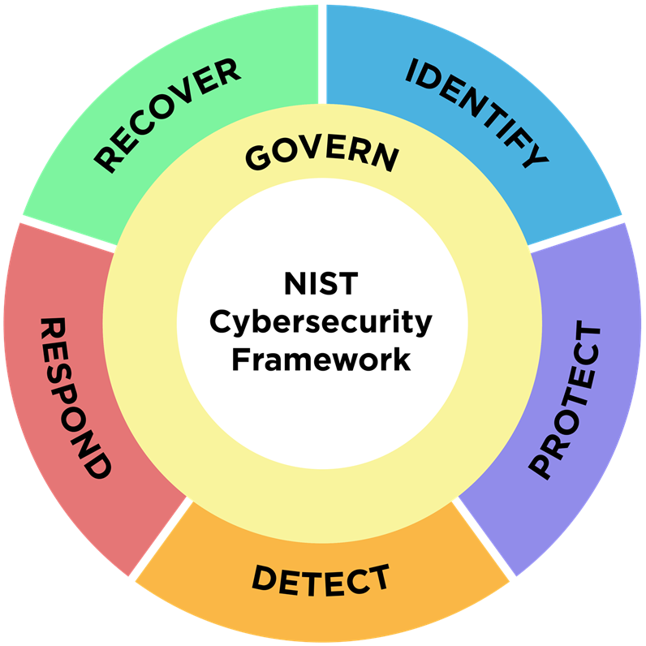
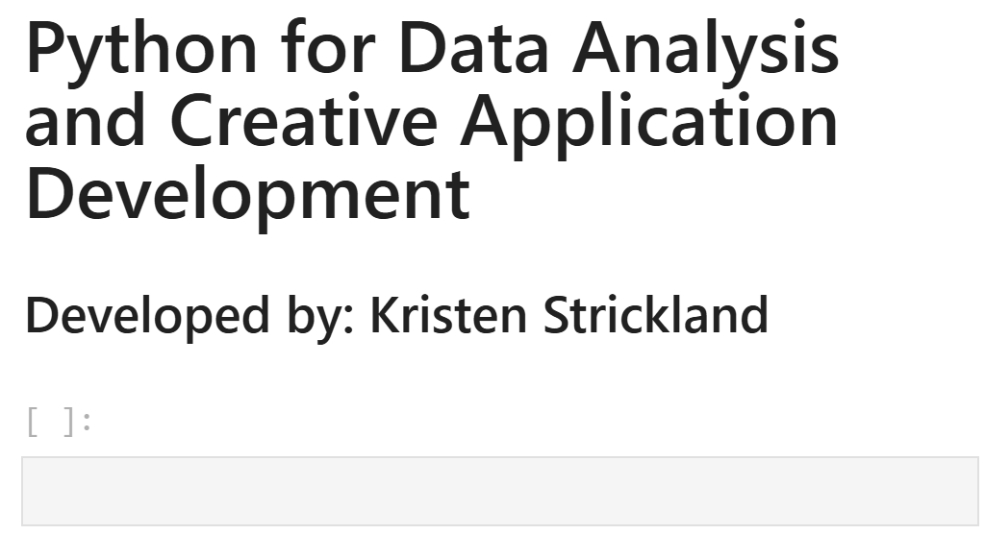
Notes:
Overview (1 slide):
Background and motivation.
Why is this topic important? Who benefits?

Slide 2

Overview
Organizations must have a framework for how they deal with both attempted and successful cyberattacks.
One well-respected model, the NIST Cybersecurity Framework (CSF), explains how to identify attacks, protect systems, detect and respond to threats, and recover from successful attacks.
Prioritizing cyber resiliency starts with understanding an organization's current cybersecurity risks.
This is achieved via the "Identify" function of the CSF and broken down into three (3) main categories:
Asset Management (ID.AM)
Risk Assessment (ID.RA)
Improvement (ID.IM)
Notes:
Overview (1 slide):
Background and motivation.
Why is this topic important? Who benefits?

Slide 3
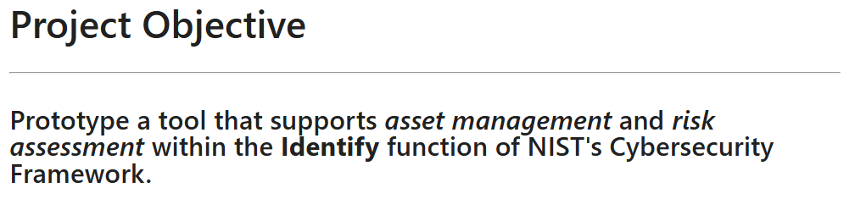
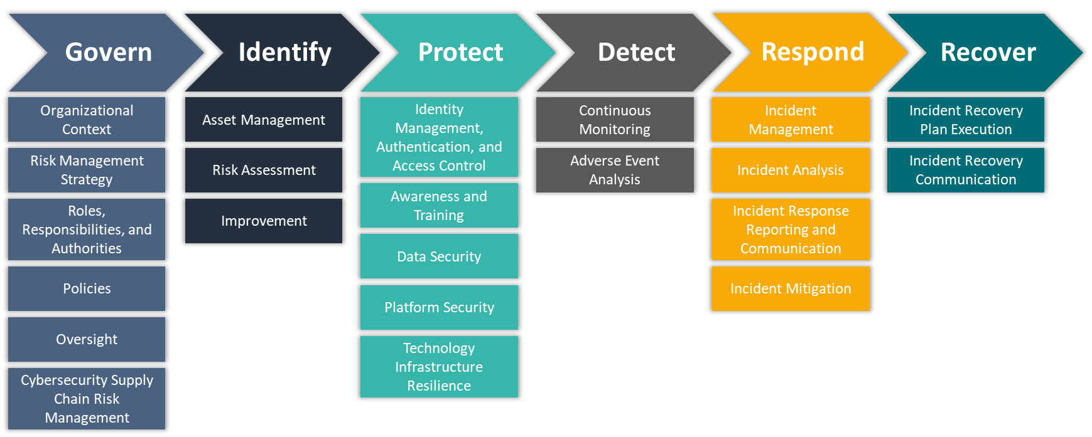

Overview
Notes:
Overview (1 slide):
Background and motivation.
Why is this topic important? Who benefits?

Slide 4
Data Description
The core dataset driving this application is user-defined. Each user ingests CPEs using F1 (Asset Inventory Module) of the tool to generate personalized datasets. In other words, the application itself generates the dataset at runtime rather than relying on a fixed third-party file. This bakes in versatility as a core component.
Why This Approach
Tailored Relevance: Users see only vulnerabilities that apply to their stack—no noise from unrelated products.
Privacy: Because the whitelist is entered directly into the app and never leaves the tenancy, no proprietary system details are exposed to third parties.
Notes:
Overview (1 slide):
Background and motivation.
Why is this topic important? Who benefits?

Slide 5
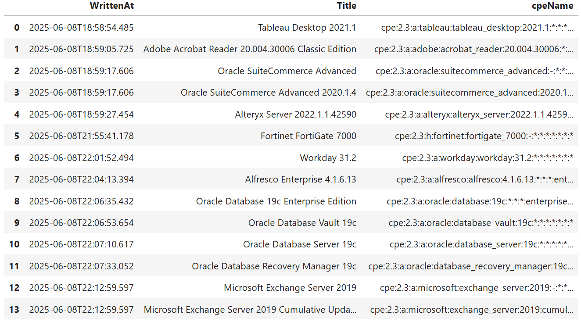
App Design: CPE Demo Data
Notes:
Overview (1 slide):
Background and motivation.
Why is this topic important? Who benefits?

Slide 6
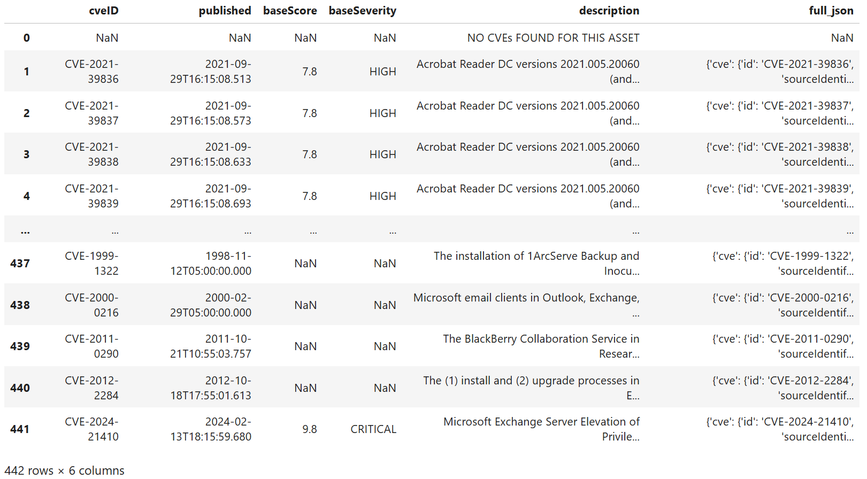
App Design: CVE Demo Data
Notes:
Overview (1 slide):
Background and motivation.
Why is this topic important? Who benefits?

Slide 7
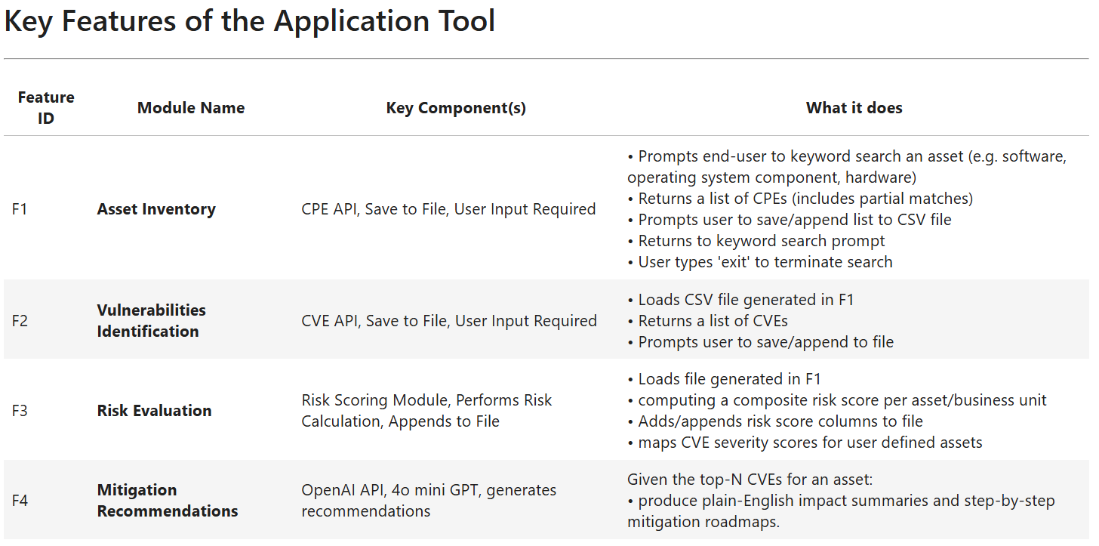
App Design: Main Components
Notes:
Overview (1 slide):
Background and motivation.
Why is this topic important? Who benefits?

Slide 8
Functions
CPE/CVE Retrieval Tool
Risk Scoring Dashboard
Notes:
Overview (1 slide):
Background and motivation.
Why is this topic important? Who benefits?

Slide 9
F1: Asset Inventory (CPE Retrieval)
Intended Purpose of Code
The below code was generated by AI to create a simple to use tool that interacts with the NVD CPE API.
Key features
User input to keyword search the CPE API
Machine outputs results
Prompts user with a yes/no/exit scenario before saving results to file
Saves search results to cpe_whitelist.csv
Does not overwrite previous outputs to file
Appends new outputs to existing outputs in file
Undo write to file option
user types 'undo' in the prompt
removes most recent record written to file
can be called repeatedly until no records written to file remain
logs unwritten records in cpe_undo_log.csv
Notes:
Overview (1 slide):
Background and motivation.
Why is this topic important? Who benefits?

Slide 10
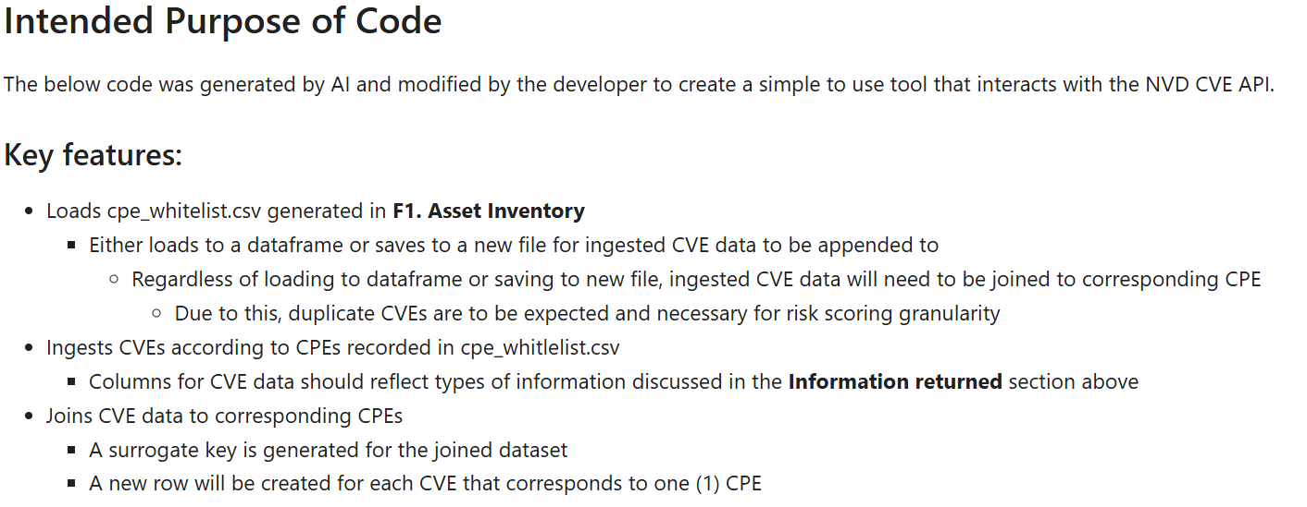
F2: Vulnerability Identification (CVE Retrieval)
Notes:
Overview (1 slide):
Background and motivation.
Why is this topic important? Who benefits?

Slide 11
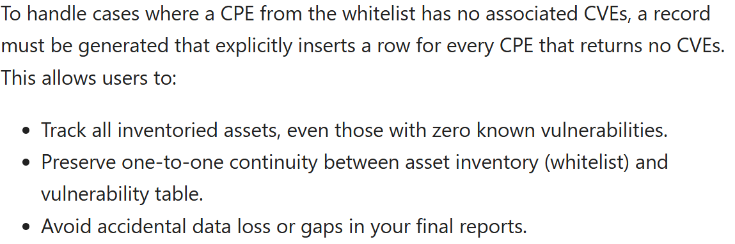
F2: Vulnerability Identification (CVE Retrieval)
Notes:
Overview (1 slide):
Background and motivation.
Why is this topic important? Who benefits?

Slide 12
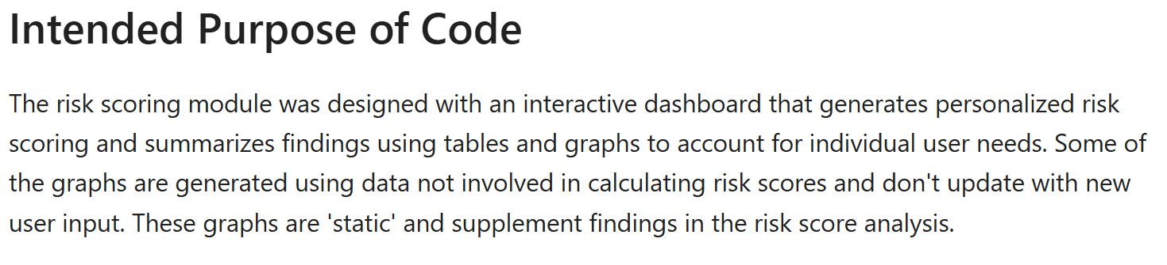
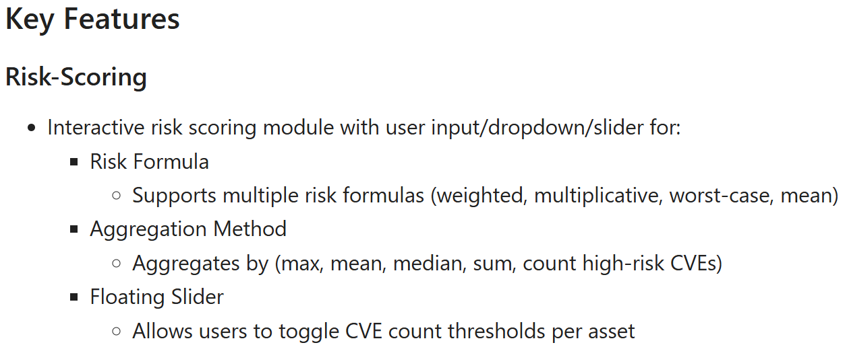
F3: Risk Scoring Dashboard
Notes:
Overview (1 slide):
Background and motivation.
Why is this topic important? Who benefits?

Slide 13
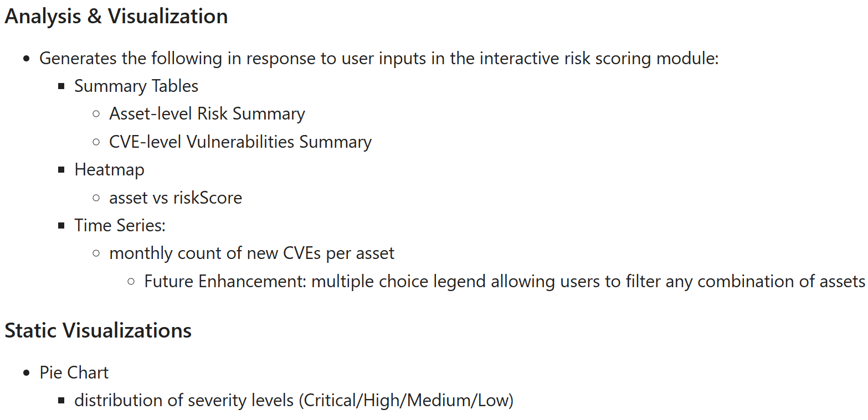
F3: Risk Scoring Dashboard
Notes:
Overview (1 slide):
Background and motivation.
Why is this topic important? Who benefits?

Slide 14
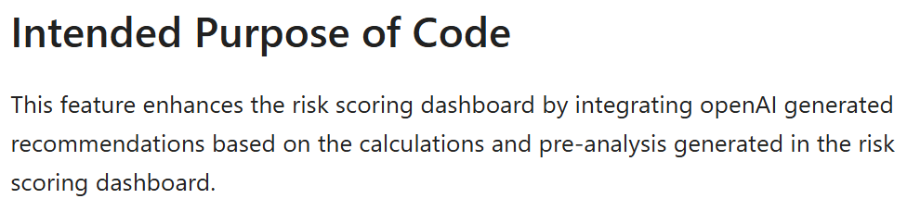
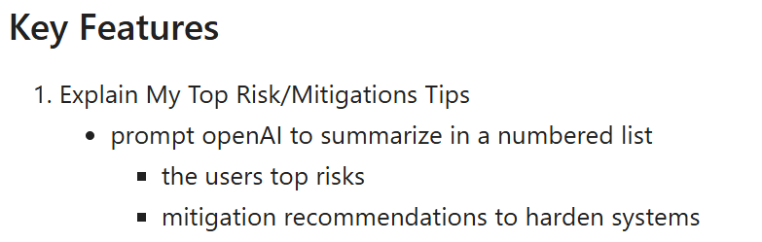
F4. AI-Driven Mitigation Recommendations
Notes:
Overview (1 slide):
Background and motivation.
Why is this topic important? Who benefits?

Slide 15
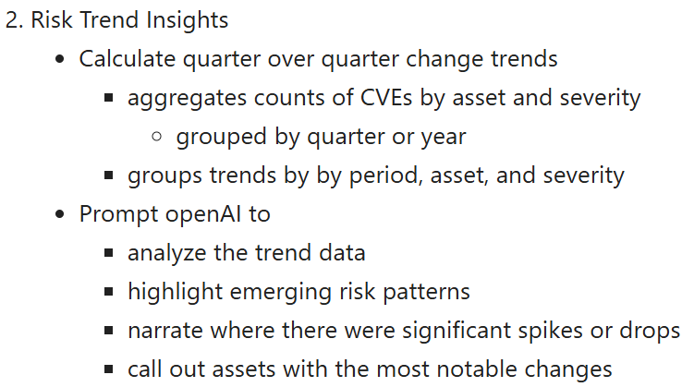
F4. AI-Driven Mitigation Recommendations
Notes:
Overview (1 slide):
Background and motivation.
Why is this topic important? Who benefits?

Slide 16
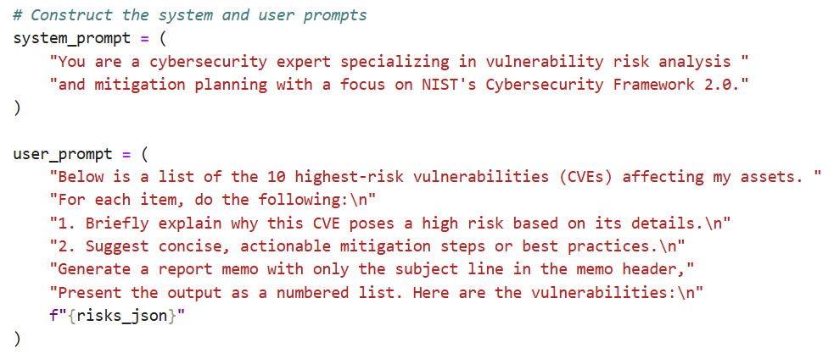
F4. AI-Driven Mitigation Recommendations
Notes:
Overview (1 slide):
Background and motivation.
Why is this topic important? Who benefits?

Slide 17
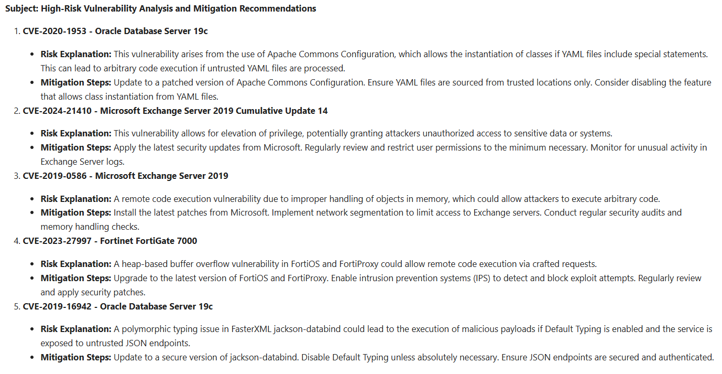
F4. AI-Driven Mitigation Recommendations
Notes:
Overview (1 slide):
Background and motivation.
Why is this topic important? Who benefits?

Slide 18
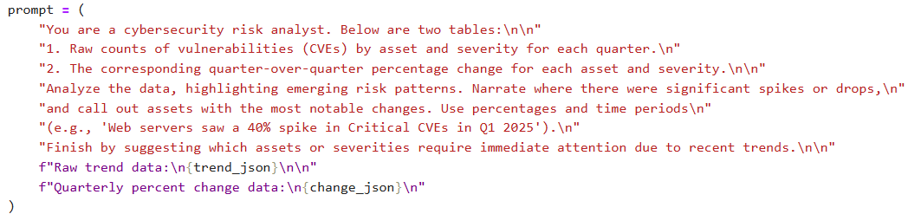
F4. AI-Driven Mitigation Recommendations
Notes:
Overview (1 slide):
Background and motivation.
Why is this topic important? Who benefits?

Slide 19
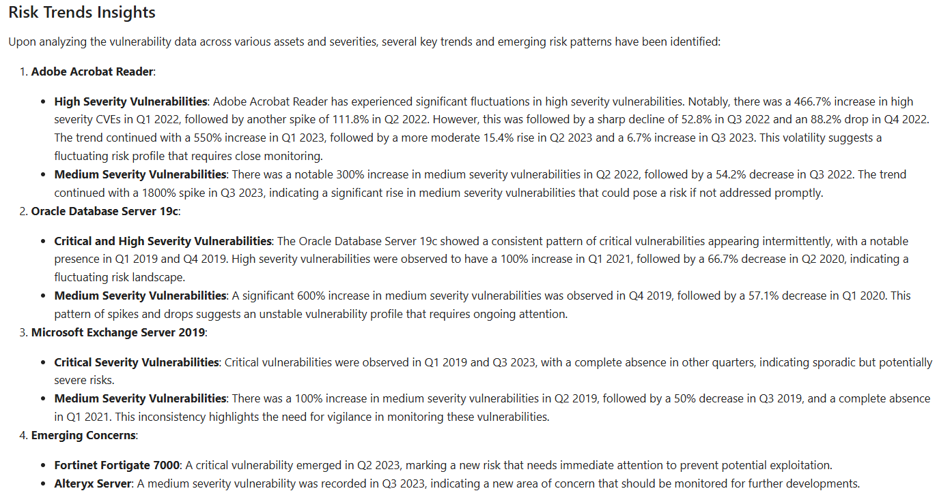
F4. AI-Driven Mitigation Recommendations
Notes:
Overview (1 slide):
Background and motivation.
Why is this topic important? Who benefits?

Slide 20
Summary
Project Goals
Framework Alignment
Implement the Identify Function of NIST’s Cybersecurity Framework (CSF), focusing on Asset Management and Risk Assessment.
Prototype Development
Build a tool composed of four modules that guide users through identifying assets, assessing vulnerabilities, calculating risk, and generating mitigation guidance.
Customization & Privacy
Ensure the tool adapts to user-specific tech stacks without exposing proprietary system data.
Results → 4 Distinct Features/Modules
F1 Asset Inventory
F2 Vulnerability Identification
F3. Risk Scoring Dashboard
F4. AI-Powered Mitigation Recommendations & Risk Trends Insights
Notes:
Overview (1 slide):
Background and motivation.
Why is this topic important? Who benefits?

Slide 21
Summary
Project Value
Improved Cyber Hygiene
Organizations gain clarity on their highest-risk assets and vulnerabilities.
User-Centric and Secure
The tool ensures privacy by generating datasets at runtime based on user input.
NIST CSF Compliance Support
Enables structured compliance and maturity tracking using a well-recognized framework.
Potential Future Enhancements
Missing Risk Scores on Initial Retrieval
The exploitabilityScore and impactScore fail to populate during initial API calls in the F2 module unless the data is first saved to and reloaded from a CSV.
No report generation integration with openAI
In future iterations, integrating report generation into the risking scoring dashboard via ‘generate’ and ‘save’ buttons
Notes:
Overview (1 slide):
Background and motivation.
Why is this topic important? Who benefits?

Slide 22
Thank you and have a great summer!
Check out the streamlit webapps for this project at:
CPE/CVE Retrieval Tool
Risk Scoring Dashboard
Documentation, code, data, and images for this project can be found on my github repository:
hgbtx/cyber-risk-scoring
Notes:
Overview (1 slide):
Background and motivation.
Why is this topic important? Who benefits?

